Slide 1
Thank you Healthy Start “angels” for being protectors of Florida’s babies

Slide 2
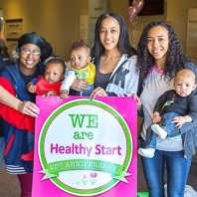
Healthy Start CHIPOLA
Thank you Healthy Start Angels

Slide 3
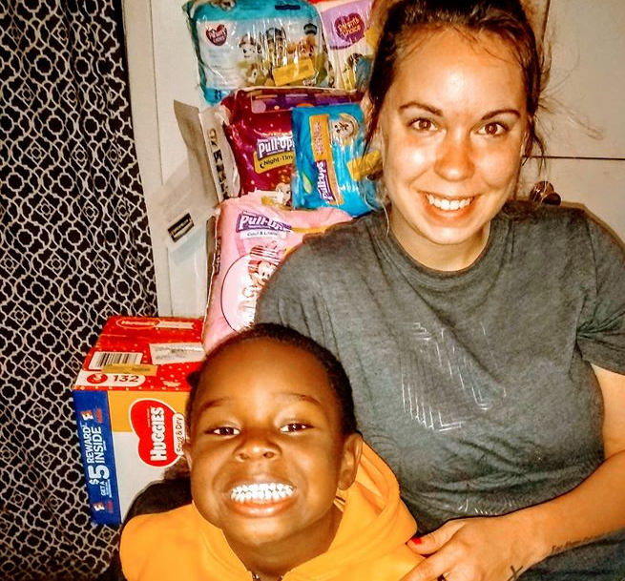
Healthy Start CHIPOLA
Thank you Healthy Start Angels

Slide 4
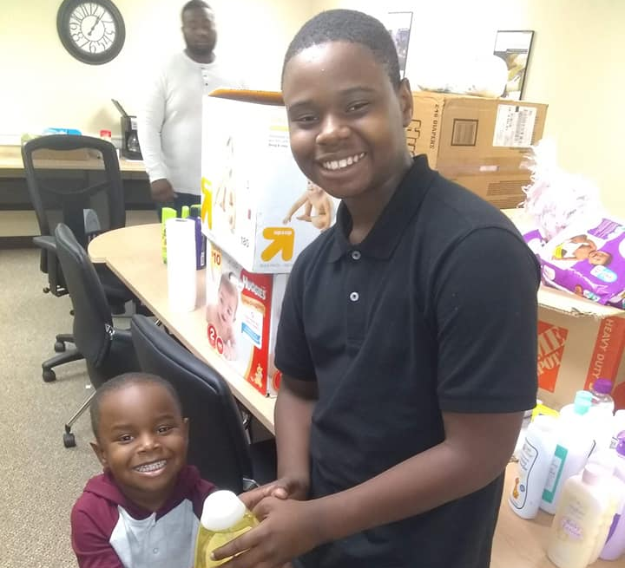
Healthy Start CHIPOLA
Thank you Healthy Start Angels

Slide 5
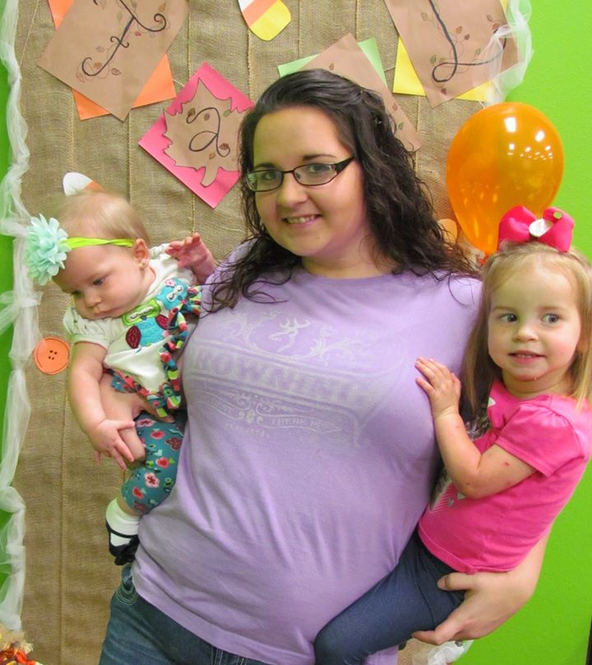
Healthy Start CHIPOLA
Thank you Healthy Start Angels

Slide 6
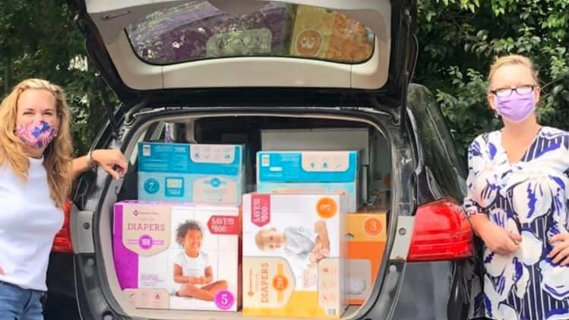
Healthy Start Bay Franklin Gulf

Slide 7
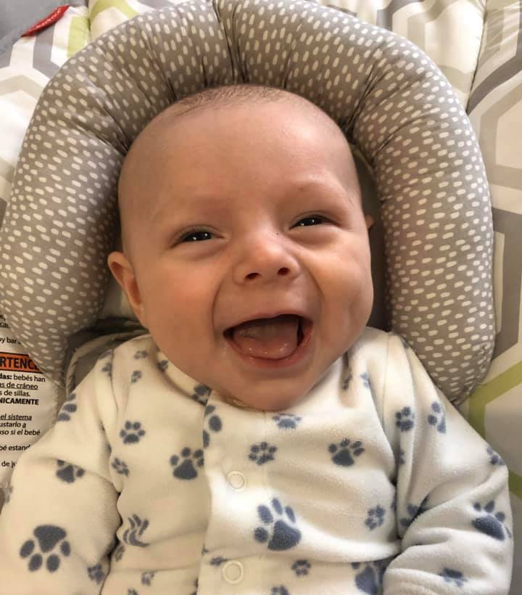
Healthy Start Bay Franklin Gulf
Thank you Healthy Start Angels

Slide 8
Healthy Start Bay Franklin Gulf

Slide 9
Healthy Start Bay Franklin Gulf

Slide 10
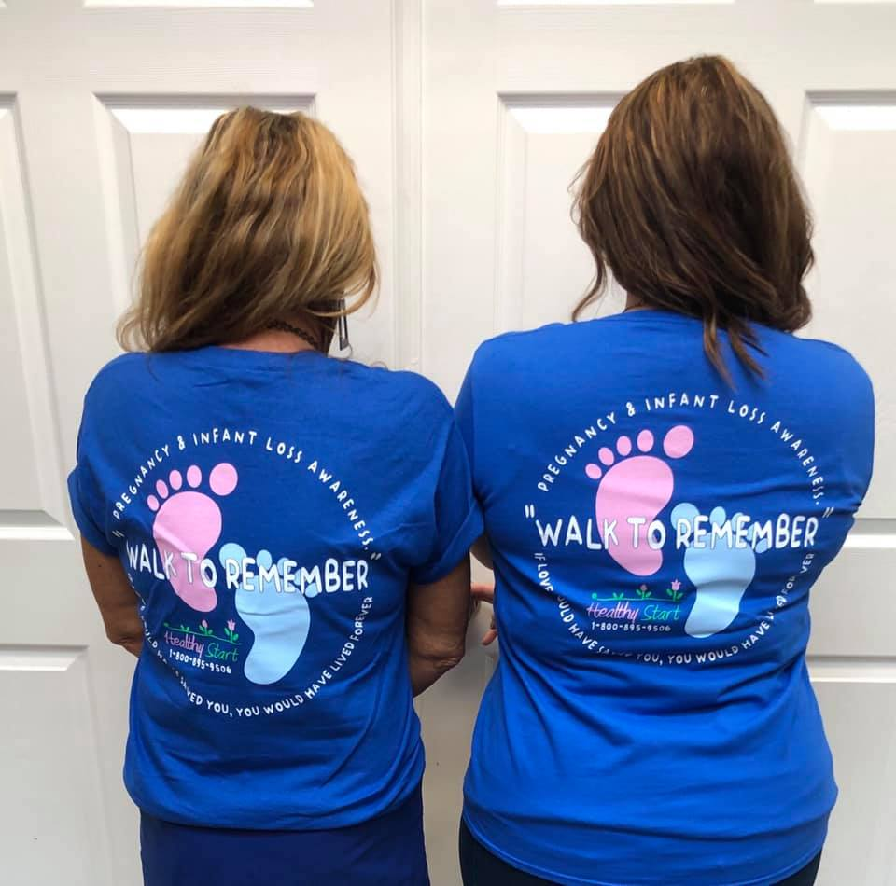
Healthy Start Bay Franklin Gulf
Thank you Healthy Start Angels

Slide 11
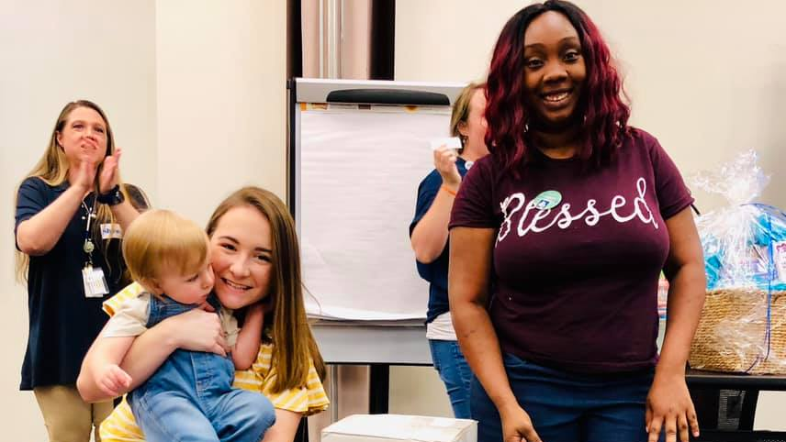
Healthy Start Bay Franklin Gulf

Slide 12
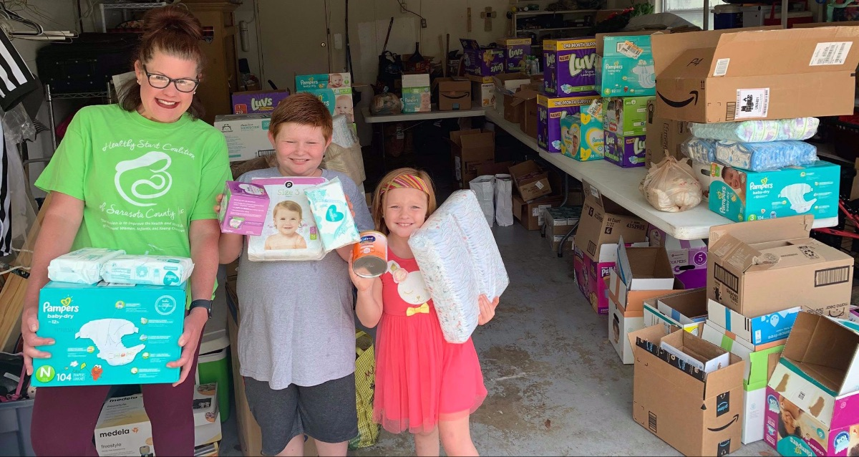
Healthy Start Sarasota Thank you Healthy Start Angels

Slide 13
Healthy Start Sarasota
Thank you Healthy Start Angels

Slide 14
Healthy Start Sarasota
Thank you Healthy Start Angels

Slide 15
Healthy Start Sarasota
Thank you Healthy Start Angels

Slide 16
Healthy Start Martin Thank you Healthy Start Angels

Slide 17
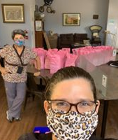
Healthy Start Martin
Thank you Healthy Start Angels

Slide 18
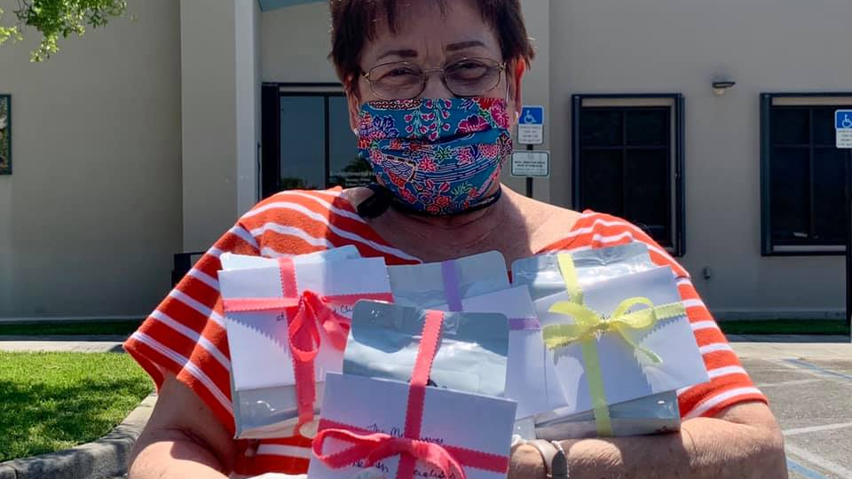
Healthy Start Martin

Slide 19
Healthy Start Martin

Slide 20
Healthy Start Martin

Slide 21
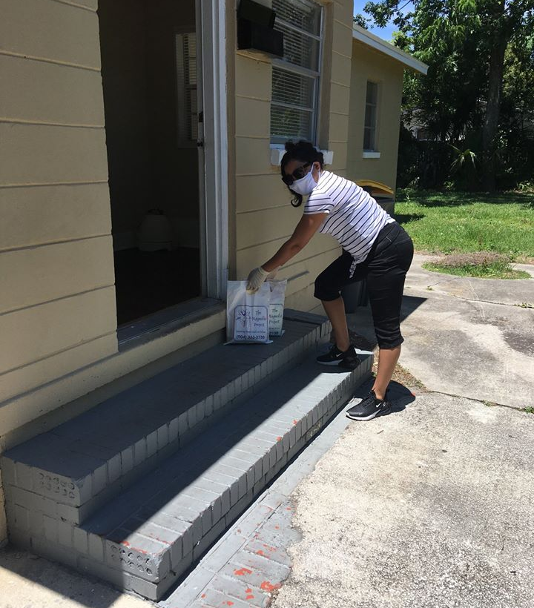
Healthy Start Northeast FL
Thank you Healthy Start Angels

Slide 22
Healthy Start Northeast FL

Slide 23
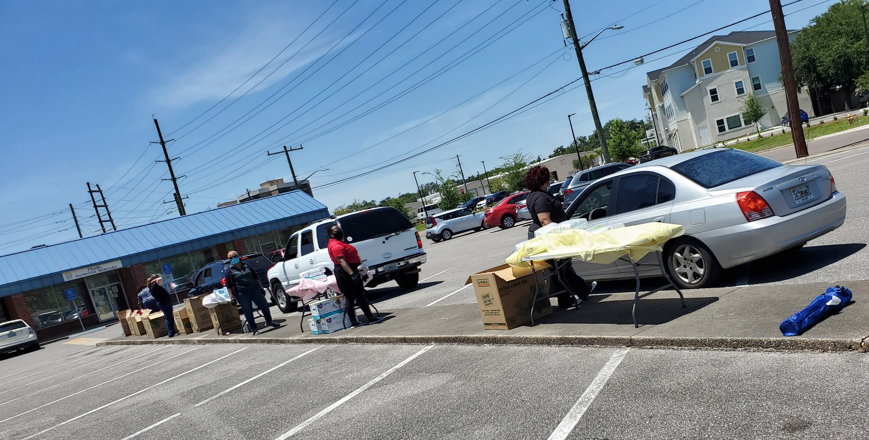
Healthy Start Northeast FL

Slide 24
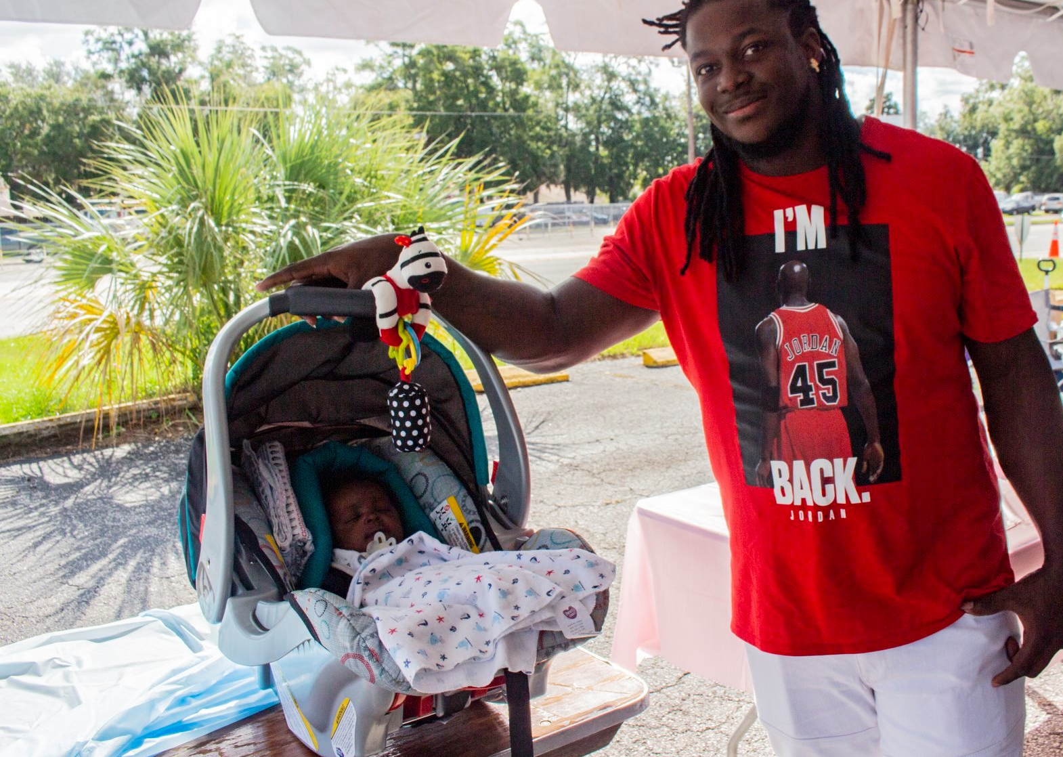
Healthy Start Northeast FL
Thank you Healthy Start Angels

Slide 25
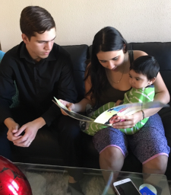
Healthy Start Northeast FL
Thank you Healthy Start Angels

Slide 26
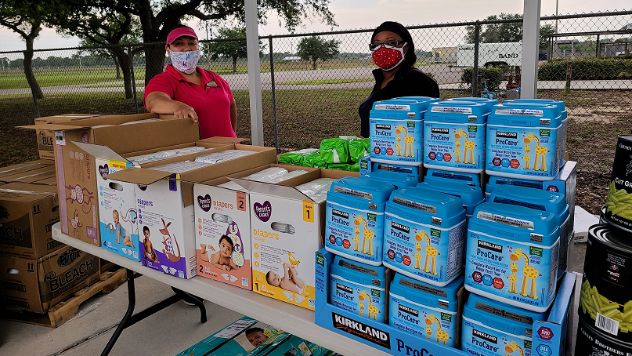
Healthy Start Southwest FL food and baby supply give away

Slide 27
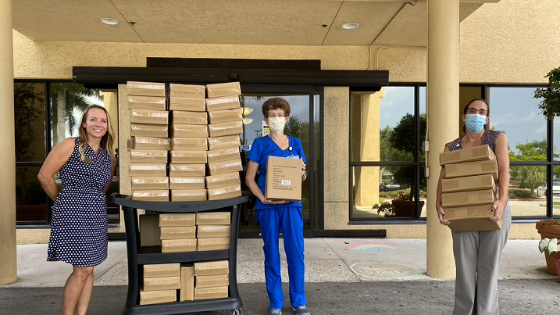
Healthy Start Southwest FL

Slide 28
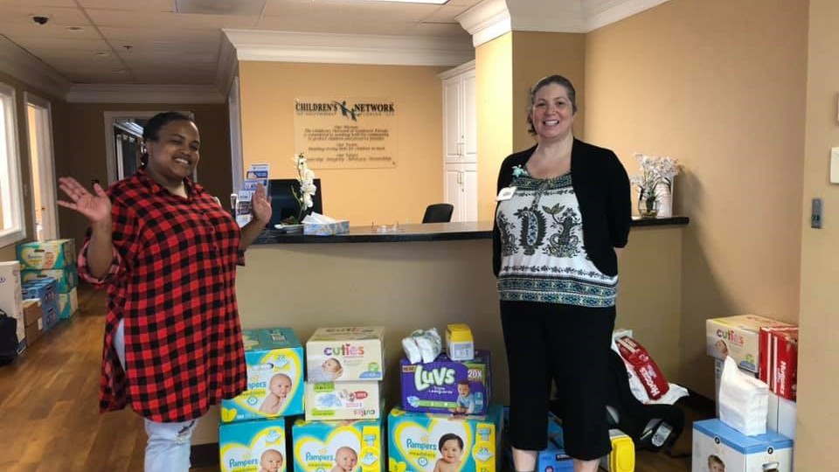
Healthy Start Southwest FL

Slide 29
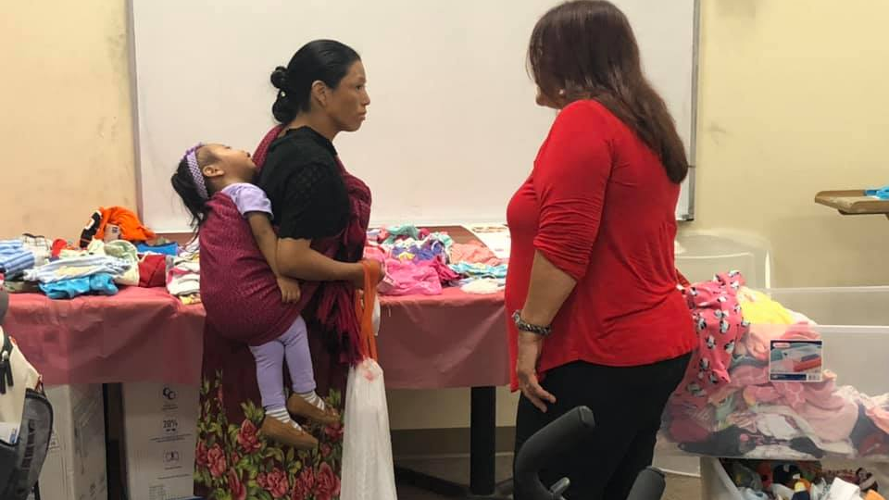
Healthy Start Southwest FL

Slide 30
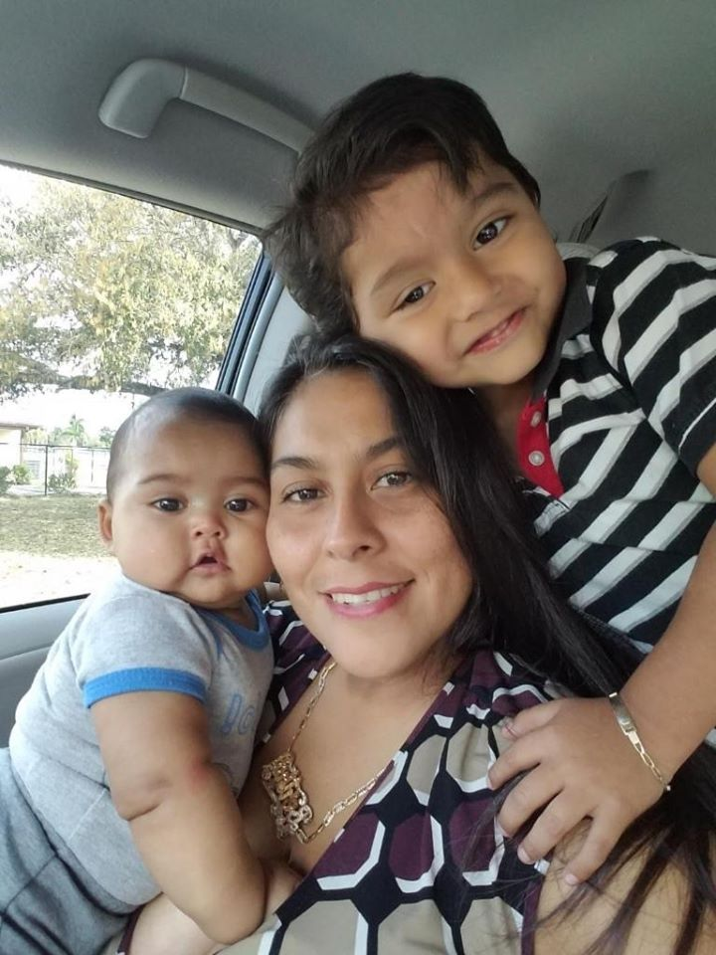
Healthy Start Southwest FL
Thank you Healthy Start Angels

Slide 31
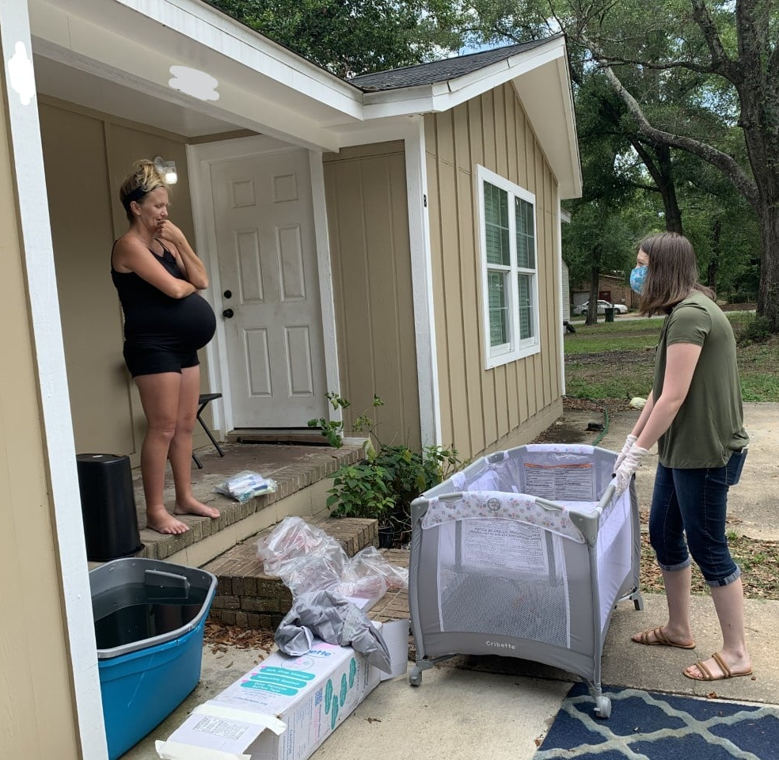
Healthy Start Escambia
Thank you Healthy Start Angels

Slide 32
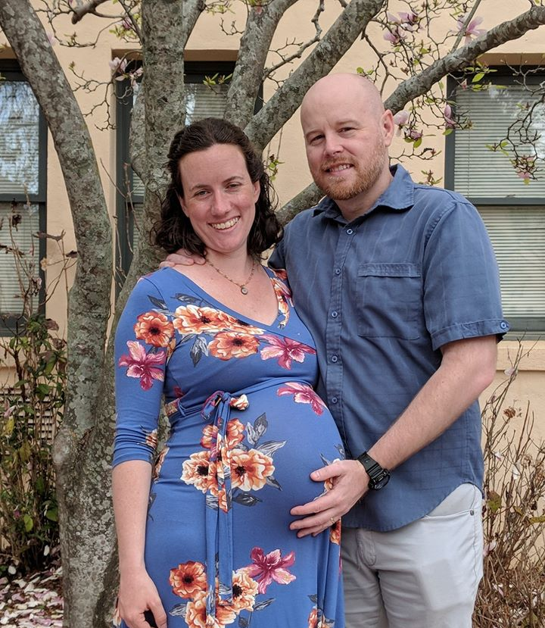
Healthy Start Escambia Thank you Healthy Start Angels

Slide 33
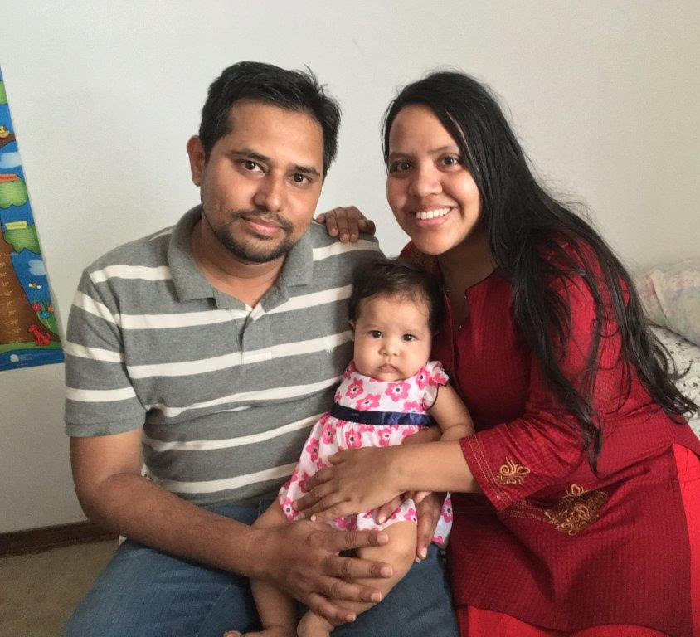
Healthy Start Escambia
Thank you Healthy Start Angels

Slide 34
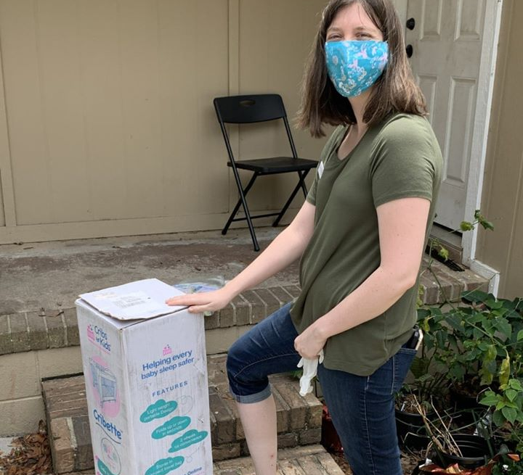
Healthy Start Escambia
Thank you Healthy Start Angels

Slide 35
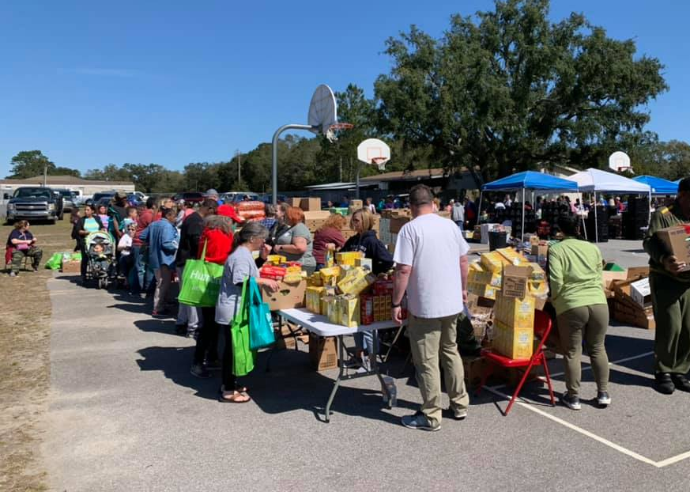
Healthy Start Escambia
Thank you Healthy Start Angels

Slide 36
Healthy Start Santa Rosa

Slide 37
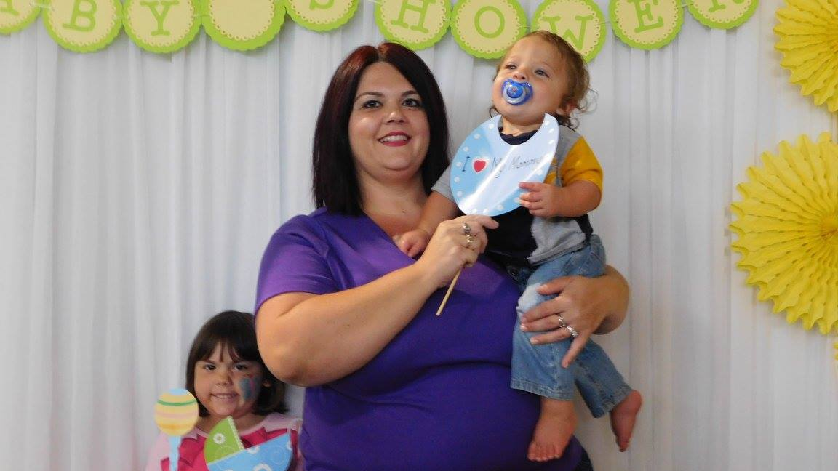
Healthy Start Santa Rosa

Slide 38
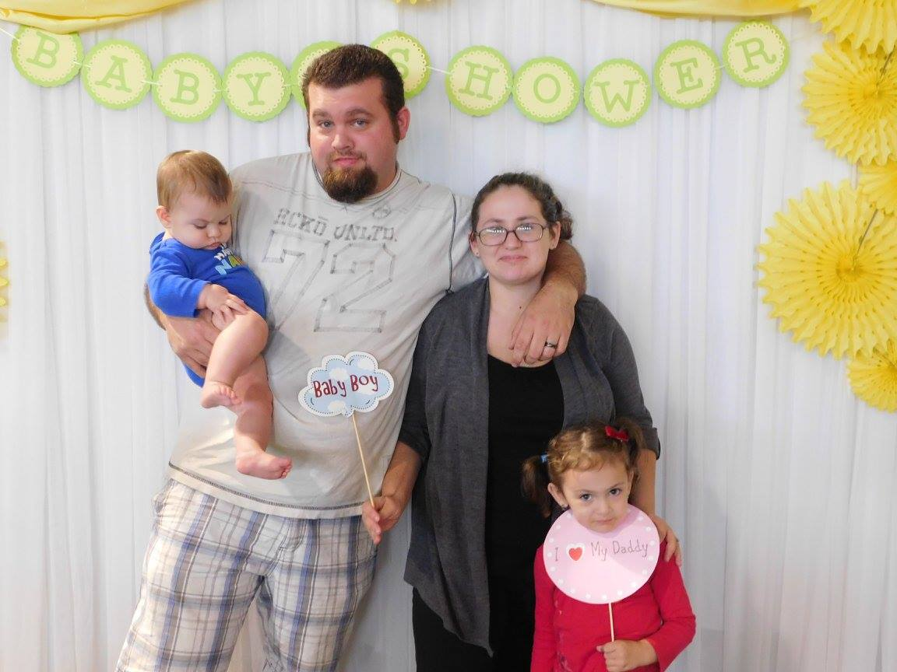
Healthy Start Santa Rosa

Slide 39
Thank you Healthy Start Angels

Slide 40
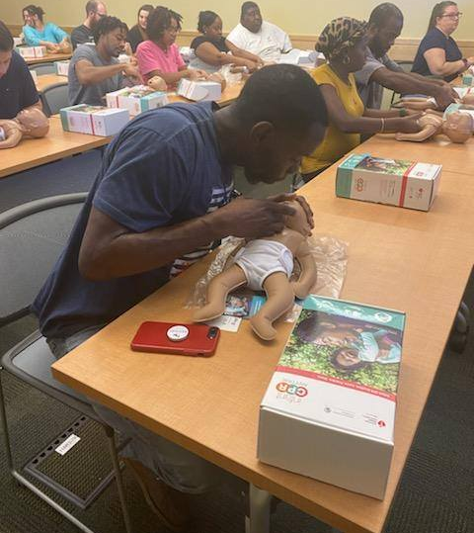
Healthy Start Capital Area
Thank you Healthy Start Angels

Slide 41
Healthy Start Capital Area

Slide 42
Healthy Start Capital Area

Slide 43
Healthy Start Capital Area

Slide 44
Healthy Start Okaloosa Walton
Thank you Healthy Start Angels

Slide 45
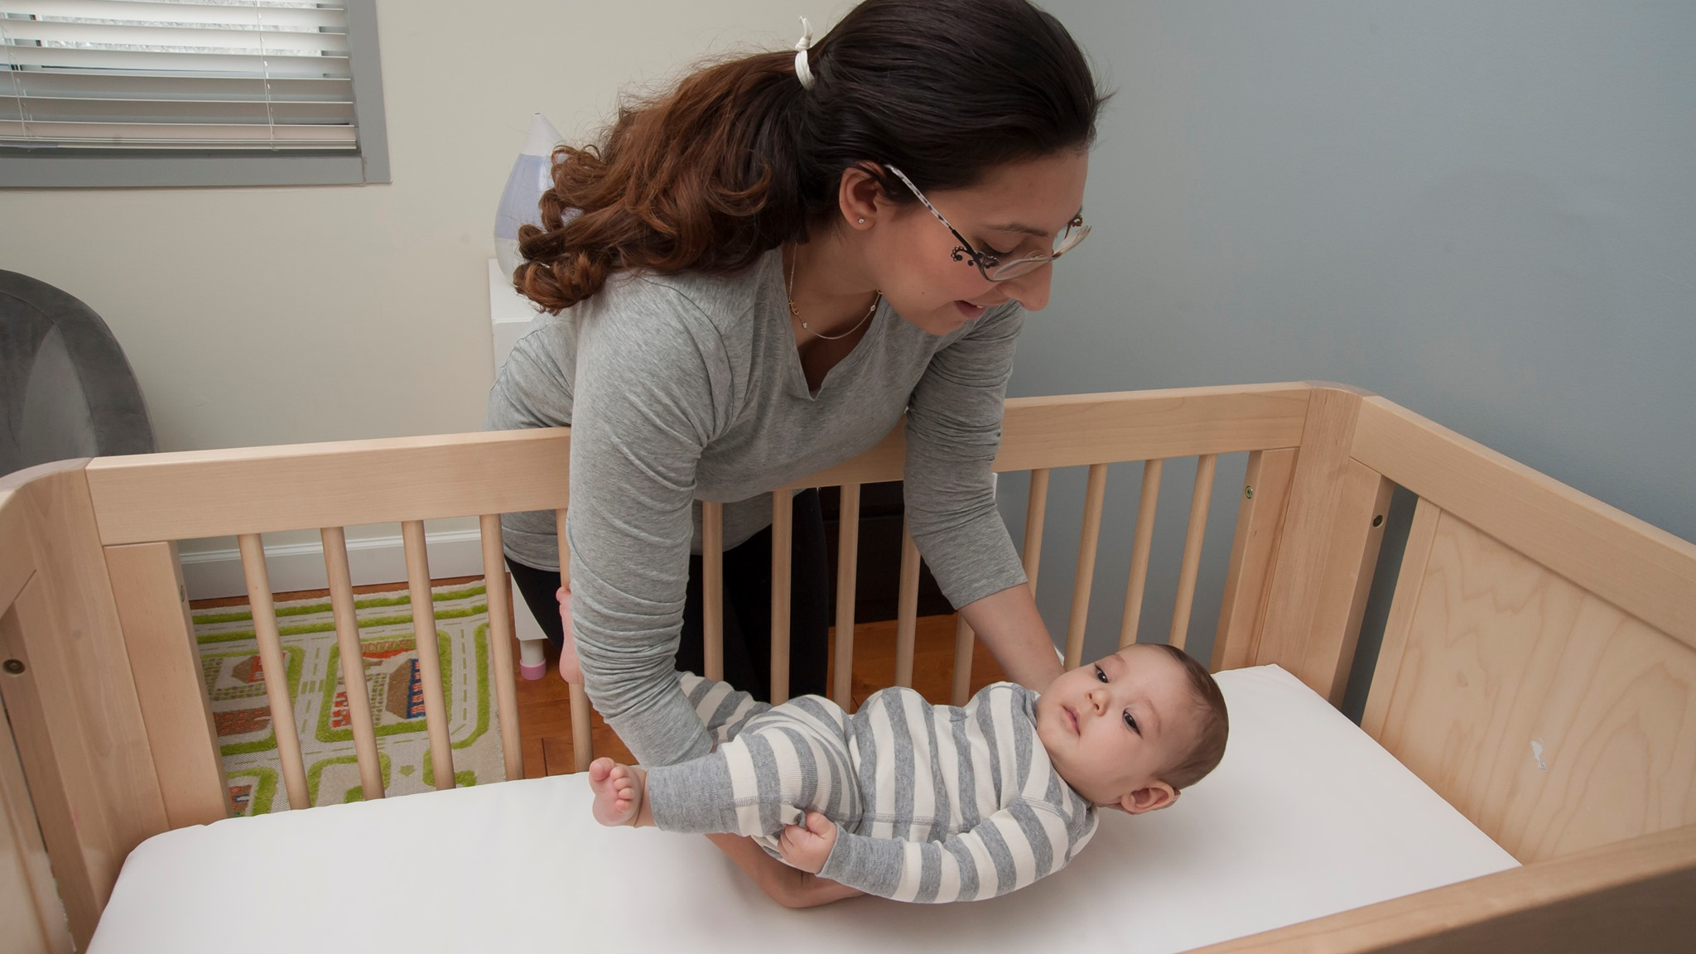
Healthy Start Okaloosa Walton

Slide 46
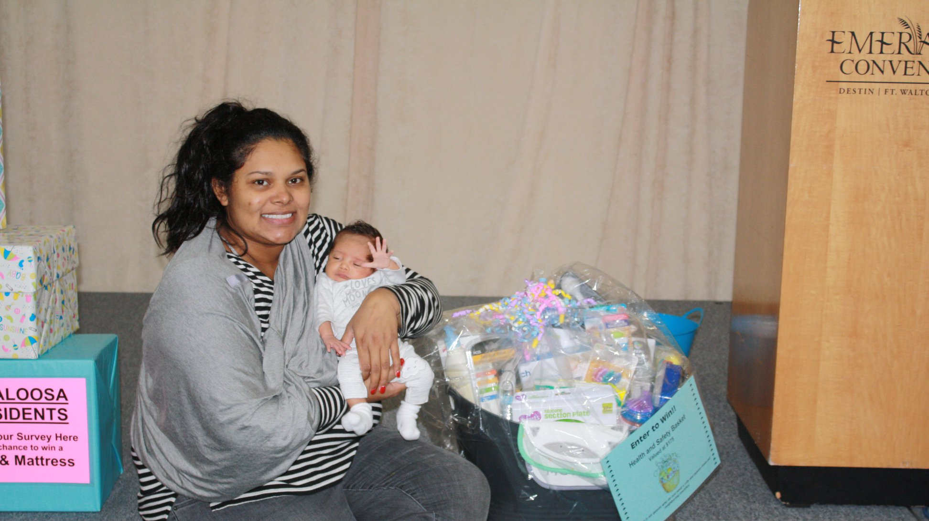
Healthy Start Okaloosa Walton

Slide 47
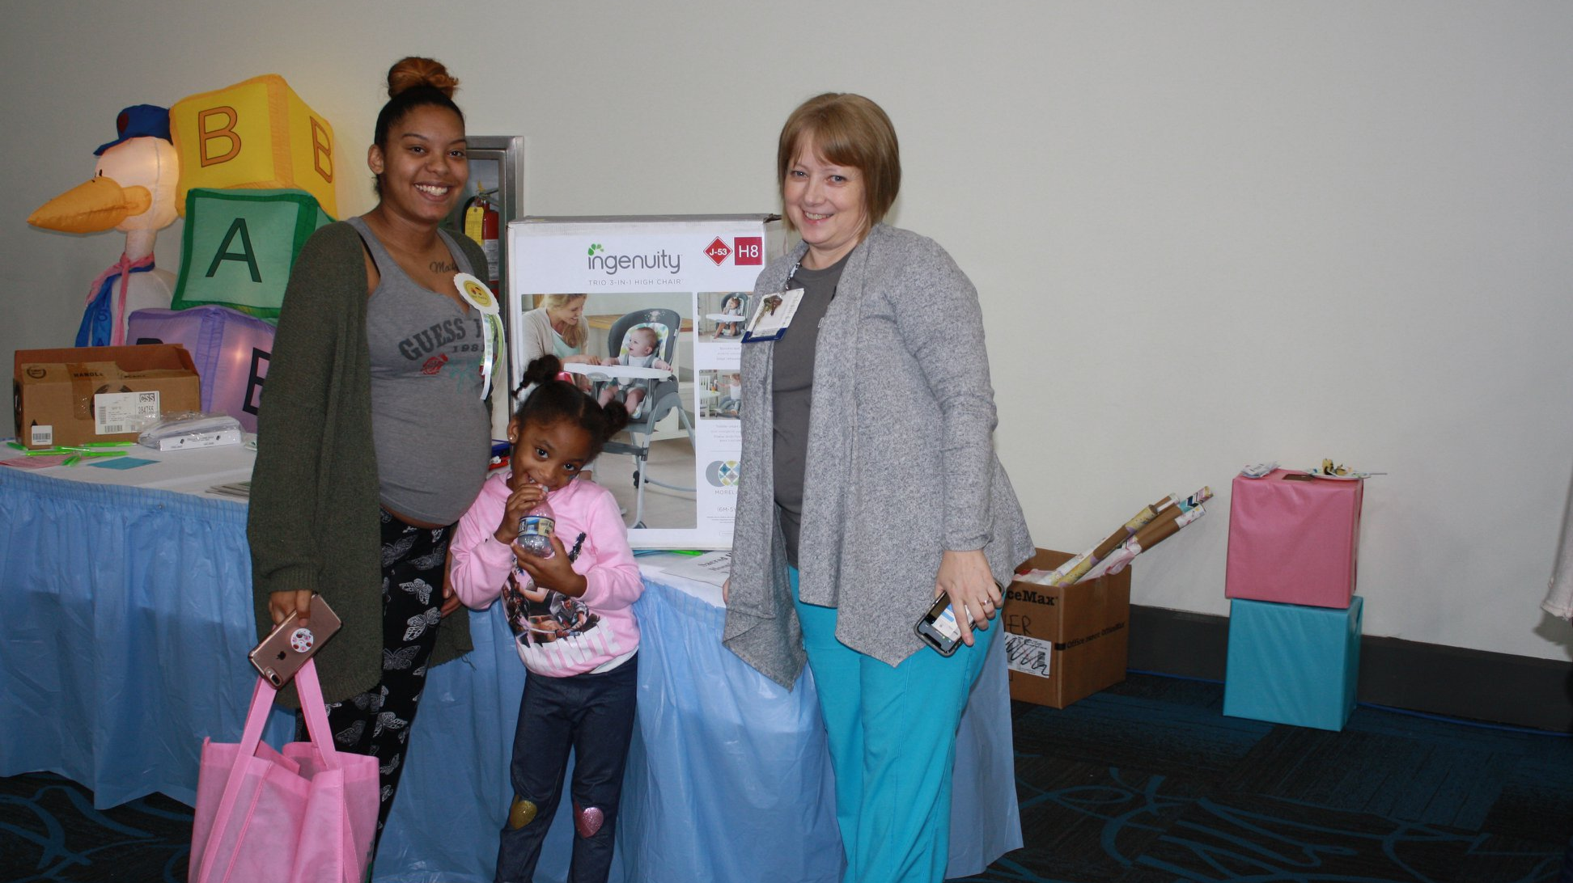
Healthy Start Okaloosa Walton

Slide 48
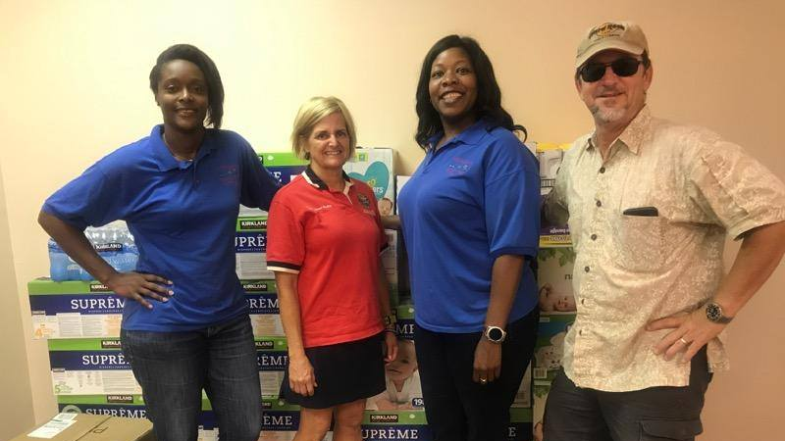
Healthy Start Gadsden Donations

Slide 49
Healthy Start Gadsden

Slide 50
Healthy Start Jefferson Madison Taylor

Slide 51
Healthy Start Jefferson Madison Taylor
Thank you Healthy Start Angels

Slide 52
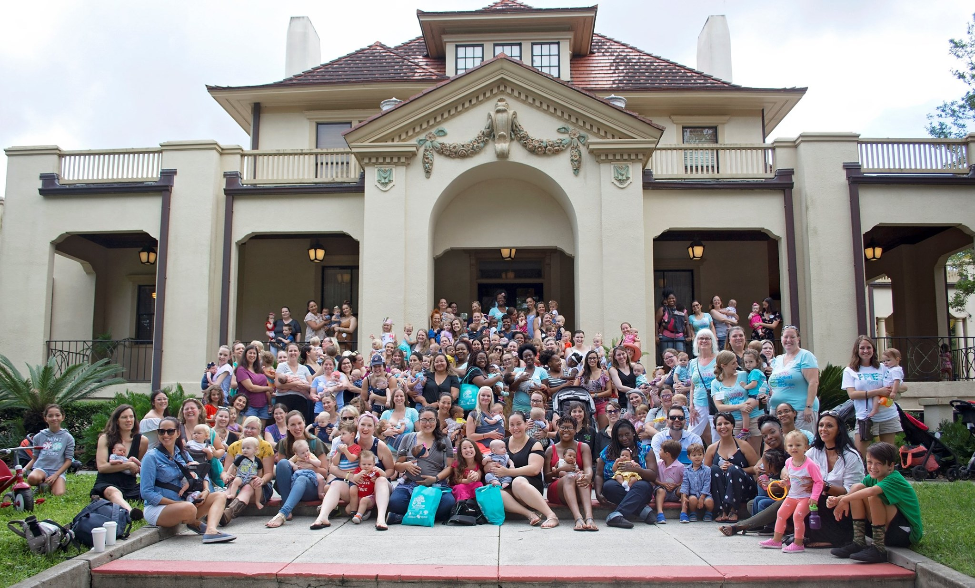
Healthy Start Central & North Central FL

Slide 53
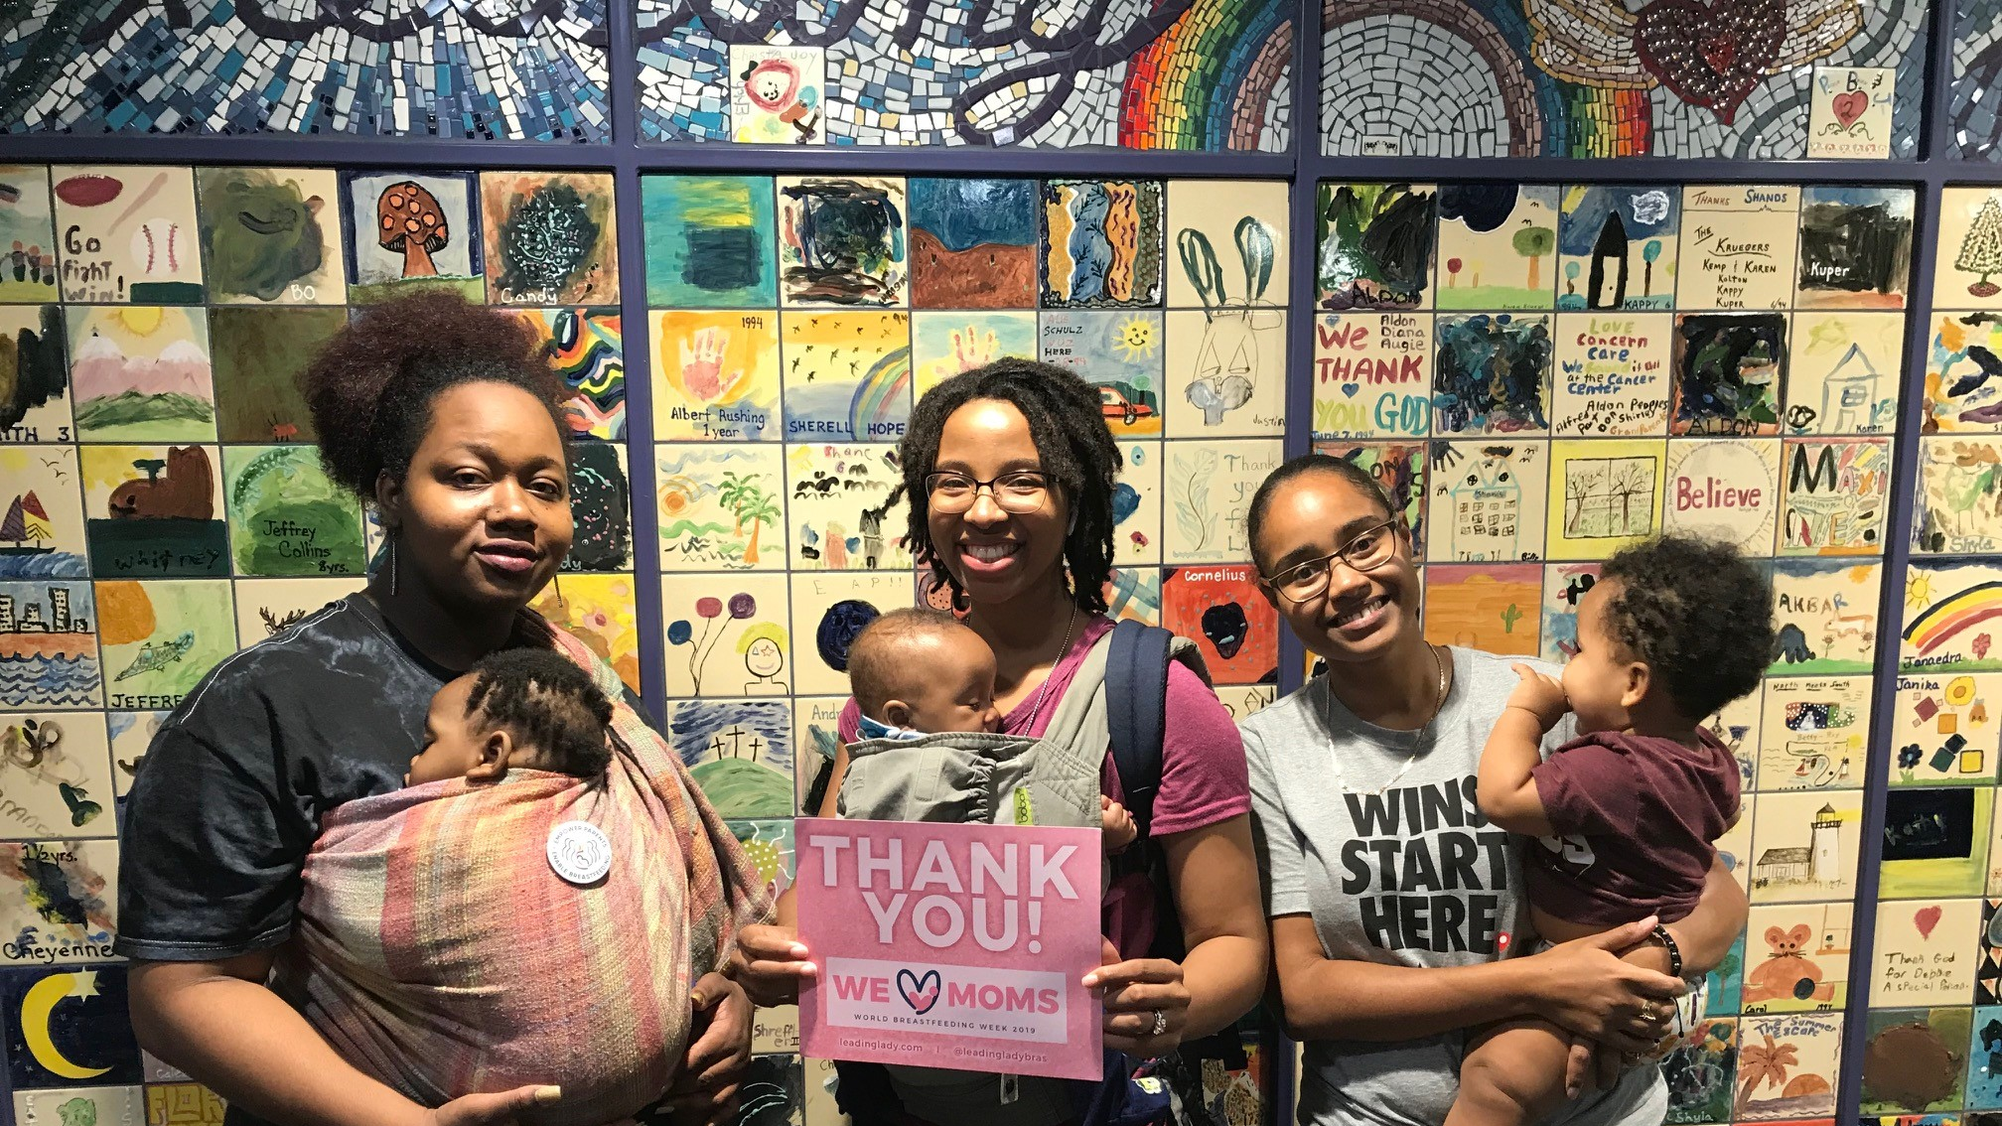
Healthy Start Central & North Central FL

Slide 54
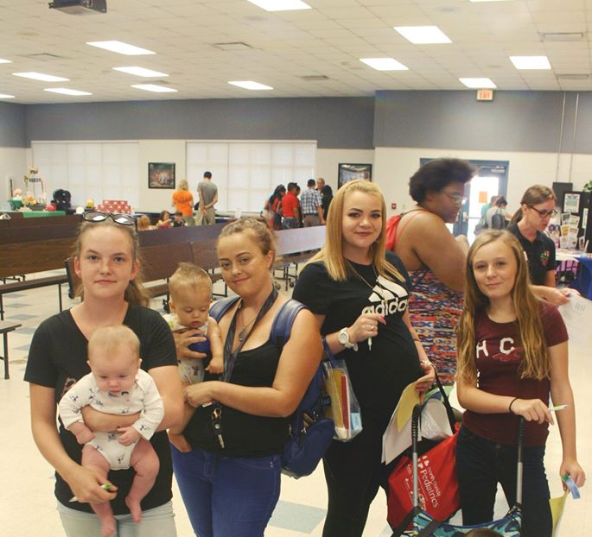
Healthy Start Central & North Central
Thank you Healthy Start Angels

Slide 55
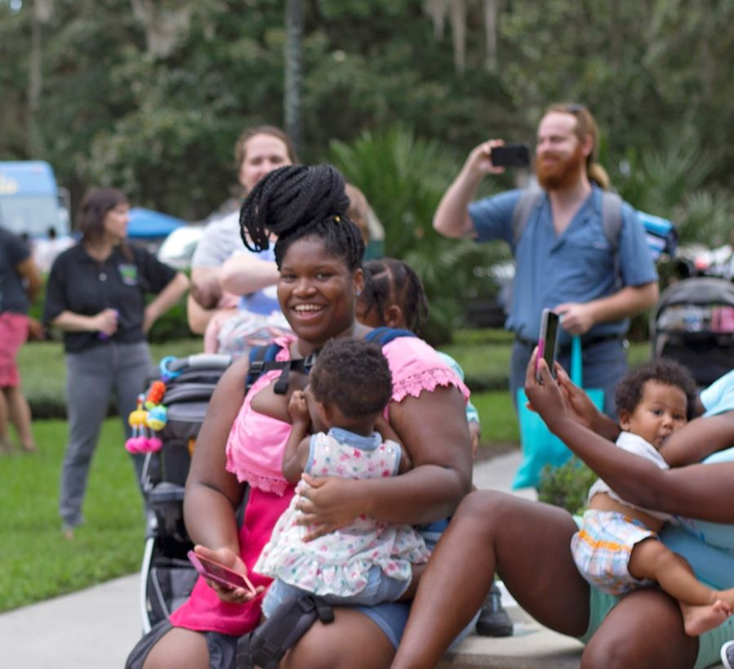
Healthy Start Central & North Central
Thank you Healthy Start Angels

Slide 56
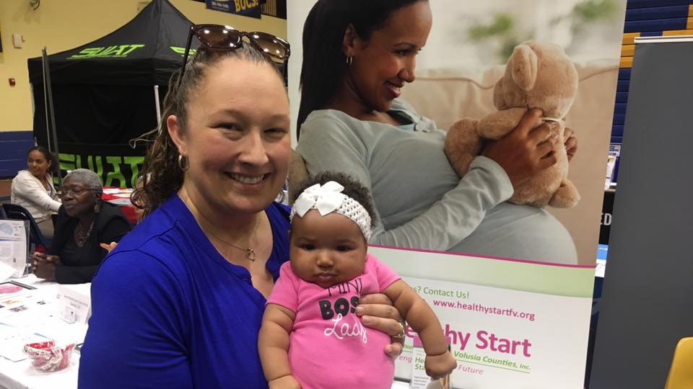
Healthy Start Flagler Volusia

Slide 57
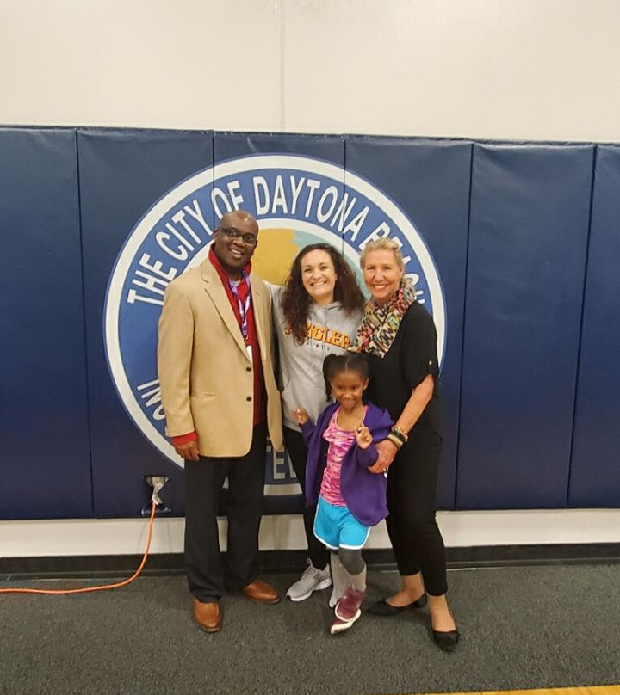
Healthy Start Flagler Volusia
Thank you Healthy Start Angels

Slide 58
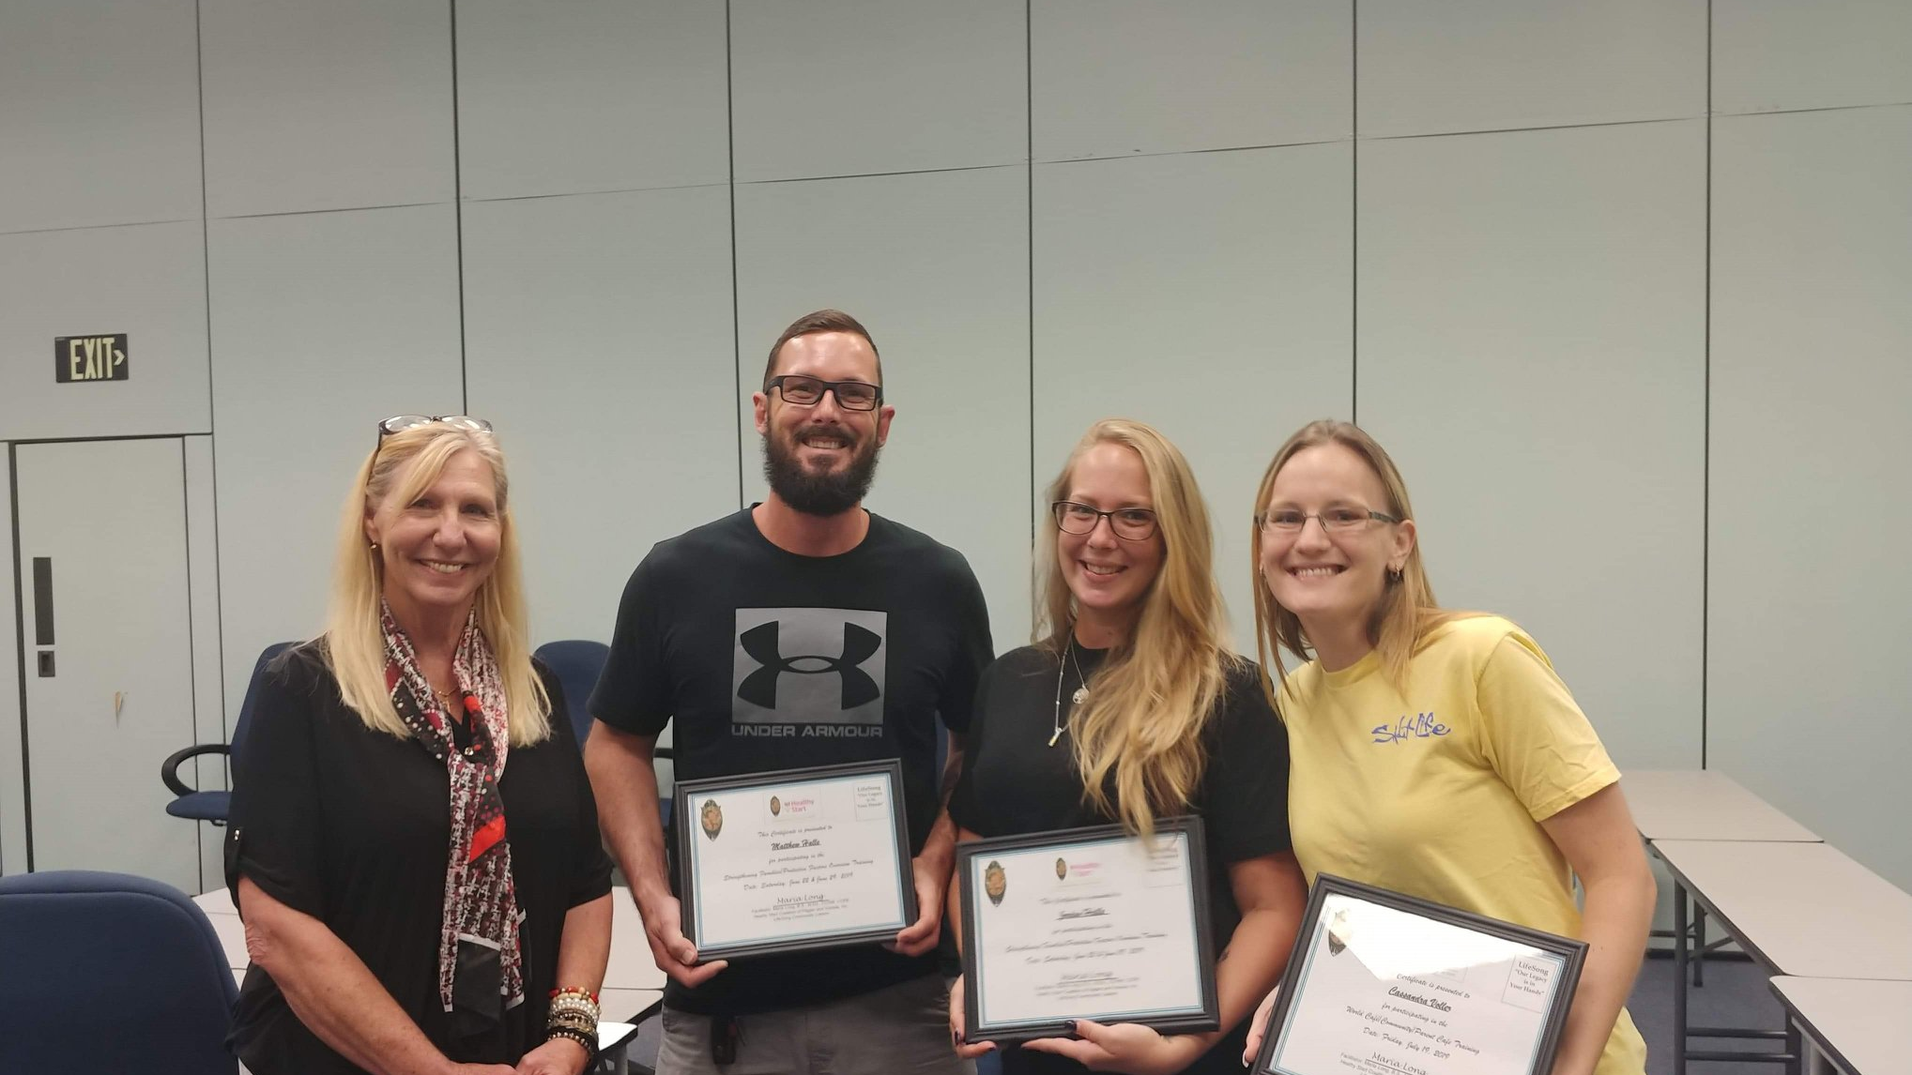
Healthy Start Flagler Volusia

Slide 59
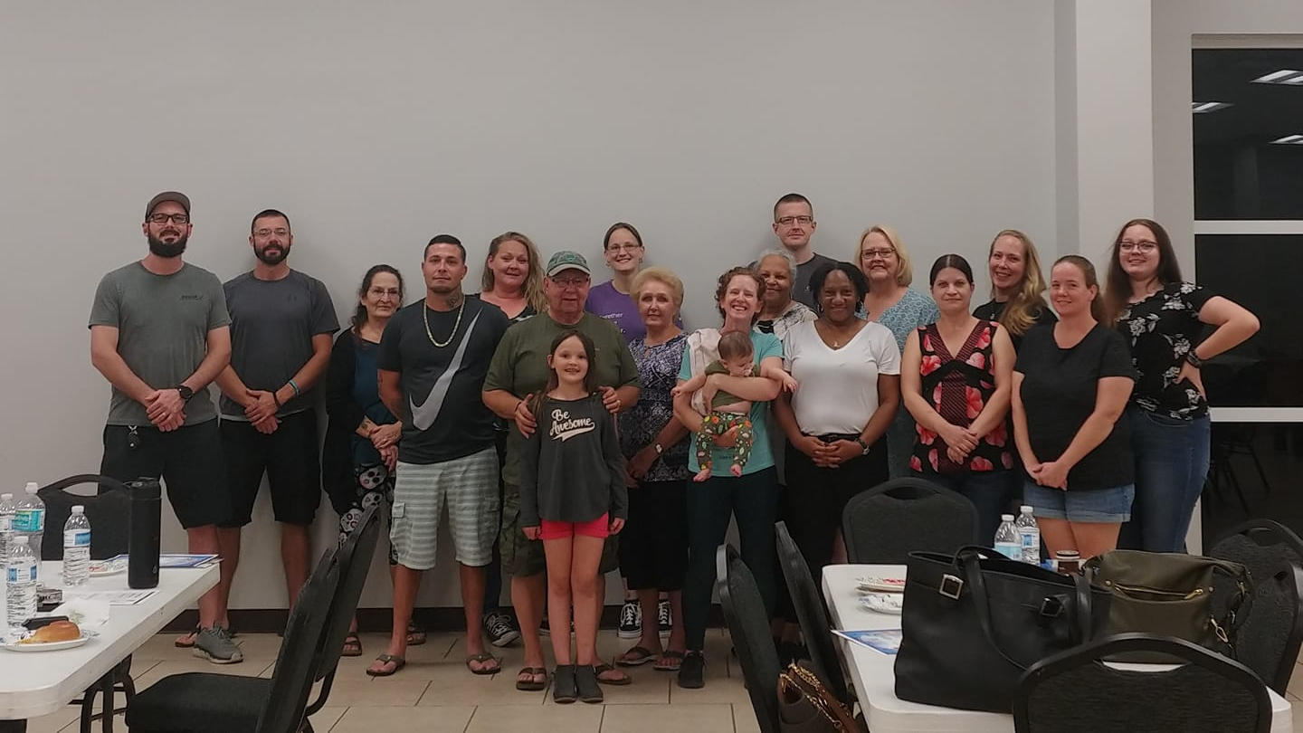
Healthy Start Flagler Volusia

Slide 60
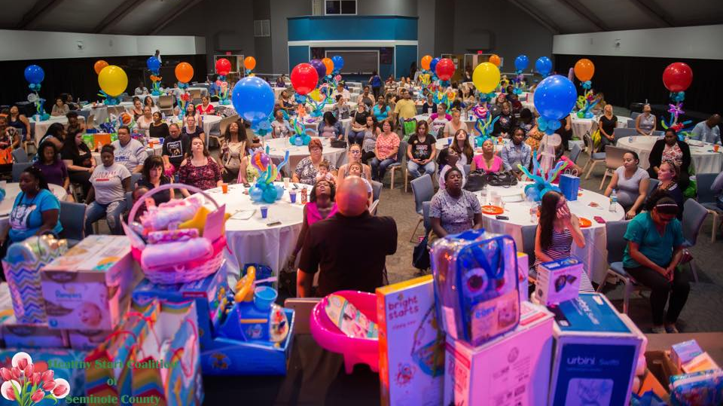
Healthy Start Seminole

Slide 61
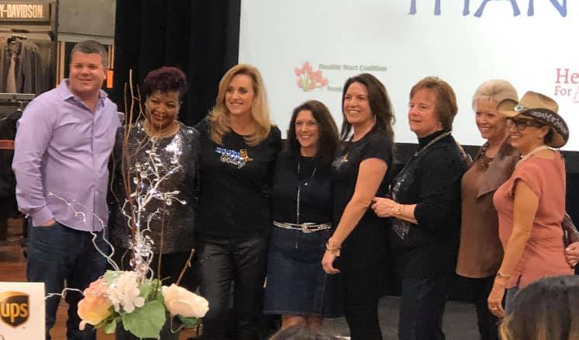
Healthy Start Seminole

Slide 62
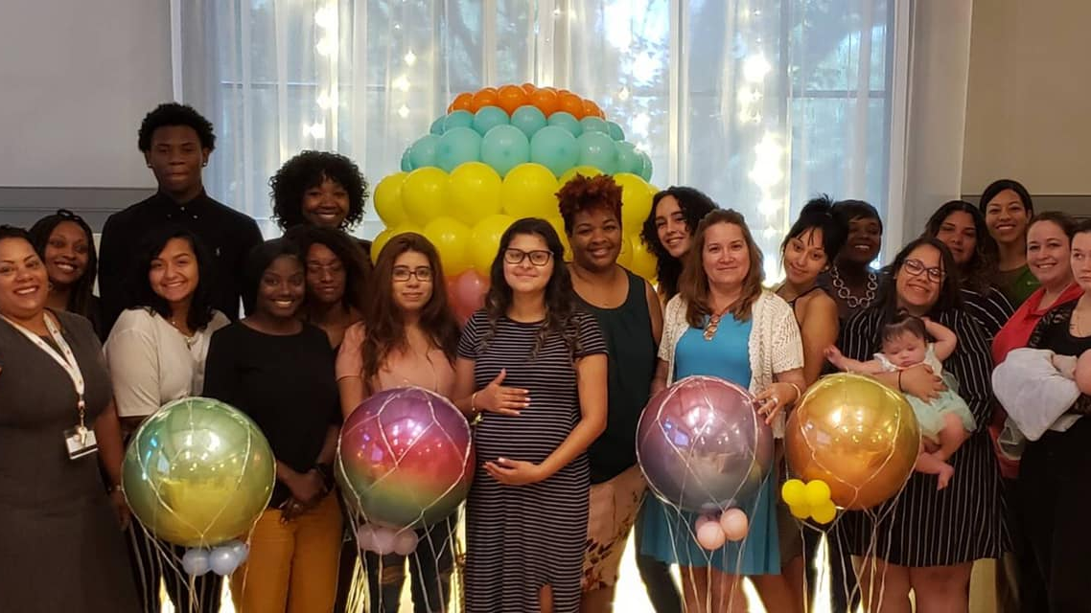
Healthy Start Seminole

Slide 63
Healthy Start Orange

Slide 64
Healthy Start Orange
Thank you Healthy Start Angels

Slide 65
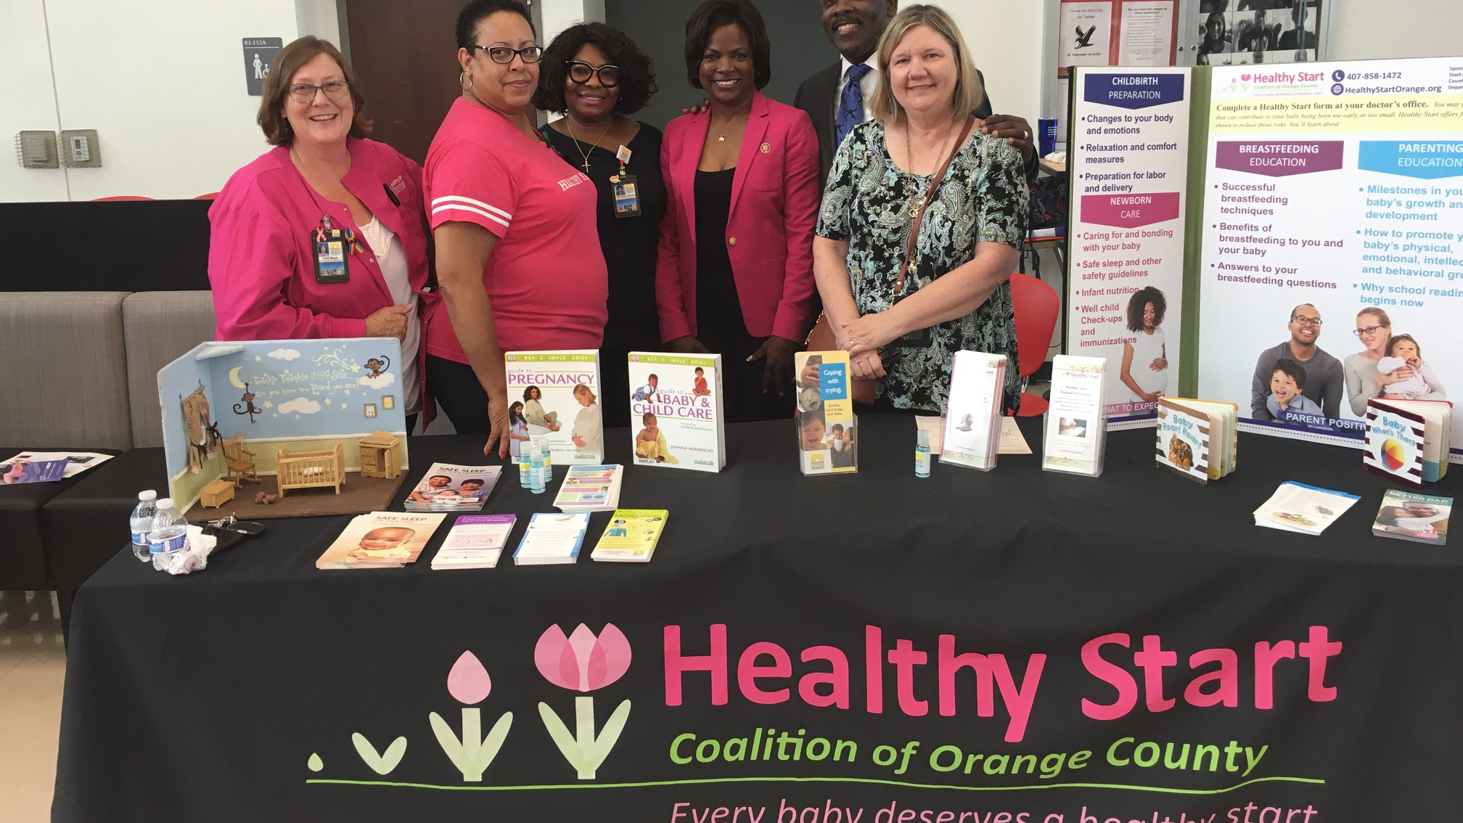

Slide 66
Healthy Start Orange Thank you Healthy Start angels

Slide 67
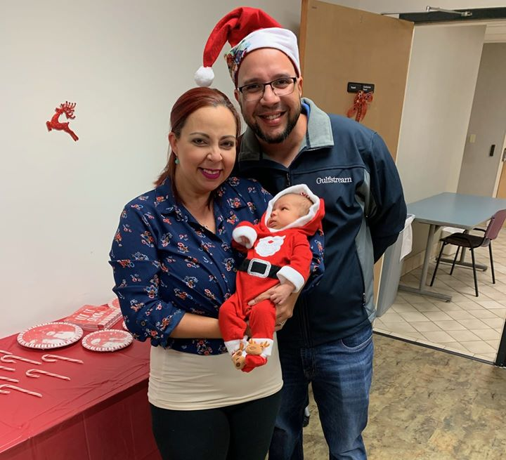
Healthy Start Osceola
Thank you Healthy Start Angels

Slide 68
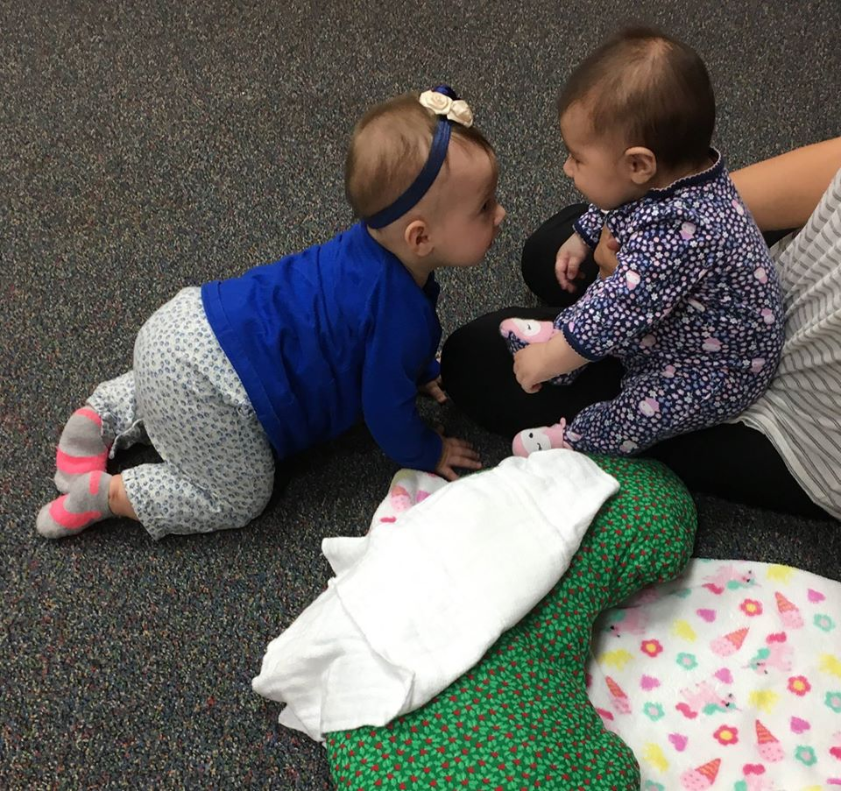
Healthy Start Osceola
Thank you Healthy Start Angels

Slide 69
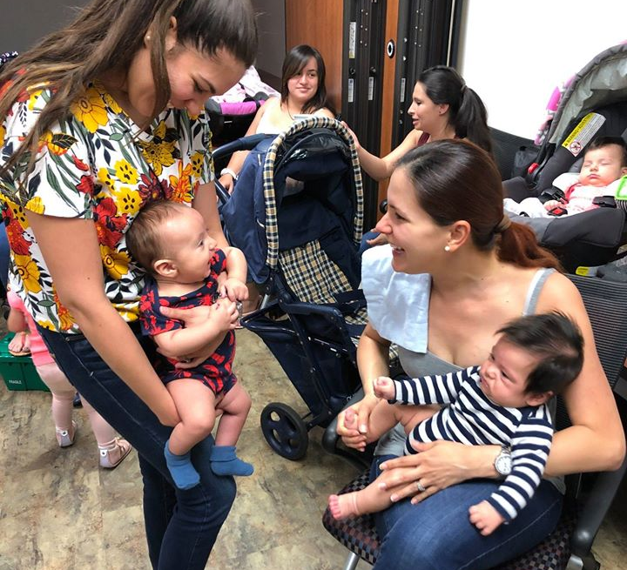
Healthy Start Osceola
Thank you Healthy Start Angels

Slide 70
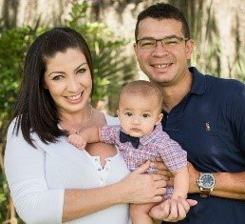
Healthy Start Hardee Highlands Polk
Thank you Healthy Start Angels

Slide 71
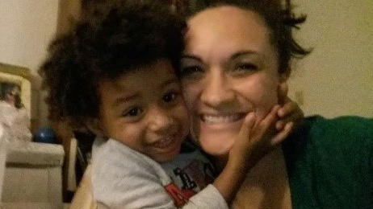
Healthy Start Hardee Highlands Polk

Slide 72
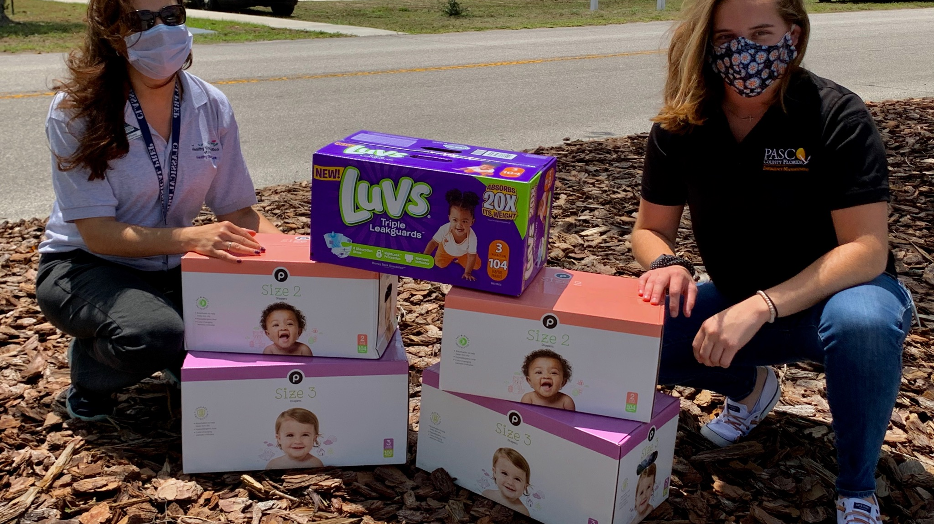
Healthy Start Pasco

Slide 73
Healthy Start Pasco
Thank you Healthy Start Angels

Slide 74
Healthy Start Martin

Slide 75
Healthy Start Pinellas
Thank you Healthy Start Angels

Slide 76
Healthy Start Pinellas

Slide 77
Healthy Start Pinellas
Thank you Healthy Start Angels

Slide 78
Healthy Start Pinellas
Thank you Healthy Start Angels

Slide 79
Healthy Start Pinellas

Slide 80
Healthy Start Pinellas

Slide 81
Healthy Start Pinellas
Thank you Healthy Start Angels

Slide 82
Healthy Start Manatee

Slide 83
Healthy Start Manatee
Thank you Healthy Start Angels

Slide 84
Healthy Start Manatee

Slide 85
Healthy Start Charlotte

Slide 86
Healthy Start Southwest FL
Thank you Healthy Start Angels

Slide 87
Healthy Start Southwest FL

Slide 88
Healthy Start Miami Dade

Slide 89
Healthy Start Miami Dade
Thank you Healthy Start Angels

Slide 90
Healthy Start Miami Dade

Slide 91
Healthy Start Miami Dade

Slide 92
Healthy Start Miami Dade

Slide 93
Healthy Start Miami Dade

Slide 94
Healthy Start Broward
Thank you Healthy Start Angels

Slide 95
Healthy Start Broward
Thank you Healthy Start Angels

Slide 96
Healthy Start Broward

Slide 97
Healthy Start Broward

Slide 98
Healthy Start Broward

Slide 99
Healthy Start St. Lucie

Slide 100
Healthy Start St. Lucie
Thank you Healthy Start Angels

Slide 101
Healthy Start St. Lucie

Slide 102
Healthy Start Okeechobee

Slide 103
Healthy Start Okeechobee
Thank you Healthy Start Angels

Slide 104
Healthy Start Okeechobee

Slide 105
Healthy Start Okeechobee
Thank you Healthy Start Angels

Slide 106
Healthy Start Indian River

Slide 107
Healthy Start Indian River

Slide 108
Healthy Start Indian River

Slide 109
Healthy Start Indian River
Thank you Healthy Start angels

Slide 110
Healthy Start Indian River

Slide 111
Healthy Start Indian River

Slide 112
Healthy Start Brevard
Thank you Healthy Start Angels

Slide 113
Healthy Start Brevard

Slide 114
Healthy Start Brevard

Slide 115
Healthy Start Keys

Slide 116
Healthy Start Keys
Thank you Healthy Start Angels

Slide 117
Healthy Start Keys
Thank you Healthy Start Angels

Slide 118
Healthy Start Keys

Slide 119
Healthy Start Keys
Thank you Healthy Start Angels

Slide 120
Fantastic organization! Helping our pregnant moms, babies and families. Thank you for all you do!! Thank you Healthy Start angels

